Slide 1
Trusted 10 Exercise

Slide 2
What is Trust? 3 Levels of Trust / Relationships
Level 1
Level 2
Level 3
Level 1 – “Hi ya”
Level 2 – Familiar
Level 3 - TRUST
Relationships / Tasks
Notes:
How do people work your way into your trusted 10??
I want to give you a sort of model – or a way you can thinking about the phenomenon of how people work their way into your trusted 10 – level 3. It happens over time – through relationship building and at work completing tasks together…
Level 1 – you know their name – say, hey – this is the biggest group of people we know – and also the most diverse
Level 2 – 10% of the outer circle tend to move into this level – where you know people on a more personal level and would trust having them work on things more close to your heart. Diversity thins out here…think of it as the familiar or comfy level – come over in my front yard type of people.
Level 3 – your “crew” – your trusted 10 or 20 or how ever many – tends to be the least diverse group (for most of us)
To put this into perspective of how it may impact diversity within teams I’ll give you an example.
When I have a chance to give someone a “sexy "assignment – high visibility, access to senior leadership, etc. – am I going to go to the most diverse group at Level 1 or people I know I trust?? Most people would say they are going to pick someone from level 2 or level 3.
What are the implications for us as an organization if we keep giving the good opportunities, promotions, stretch assignments to those in our level 2 or level 3 circle of trust then what’s going to happen with diversity on our teams…we replicate the issue of “like me bias”.

Slide 3
Jot down first name or initials of 10 people you trust
1.
2
3
4
5
6
7
8
9
10
Notes:
Write down the names or initials of 10 (or how many ever come to mind) of people you trust – trying as much as possible not to include family.
Once you have people written down let me know and we’ll move to part 2.

Slide 4
STOP
DO NOT PROCEED
UNTIL YOU COMPLETED YOUR TEN NAMES

Slide 5
Add in diversity dimensions for each person
First Name or Initial | Gender | Age | Race / Ethnicity | Education | Sexual Orientation | Level w/in org. | Country of Birth | Marital Status | Urban / Rural Upbringing | Disability Y or N?
1.
2.
3.
4.
5.
6.
7.
8.
9.
10.
Notes:
Move to part 2 of the activity – you’ll see dimensions across the top – take a few min. and go through each dimension and code each person you trust. Feel free to come up with your own code for each dimension. Only filling out as much as you know…

Slide 6
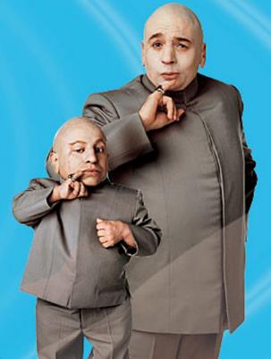
Like ME Bias
So what do we do about it?
The like me bias is just one type of bias and who we trust is often impacted the most by this. Because for most of us, we gravitate, relate to and flock to people who like us, like the same things, came from a similar place, etc.
The more we are able to talk about the like me bias and think about how it may be impacting our decision making, the more likely we will take this from the unconscious to the conscious.

Slide 7
Some additional information
Over time, if we use effective relationship building people will move beyond “I know their name” – level 1 – to level 2 – where you know more about them on a personal level, what their strengths are but maybe not as close as your closest inner circle
The most diverse group of people in your life will be in level 1, thinning out at level 2 and for most of us the least diverse is our trusted 10
What does this show – this is a way to show people how the “like me bias” impacts organizations – who is promoted, given opportunities, etc.
If you have a really “exciting or visible” assignment (access to leadership, new product, new market) – most of us would likely give that assignment to those closer to the level 3 circle of trust – if you factor in the lack of diversity that many of us have in those trusted circles, you begin to see how pervasive the like me bias can be within organizations
The “like me bias” also shows up in other areas such as hiring – when all things equal in two candidates, if you have something in common with one of the candidates you may be swayed to select them over the other person without even realizing that may be the deciding factor
A sales technique with a new customer is build rapport – how do they do that? They finds something in common with people first before talking business because that builds trust quickly.

